Slide 1



AdventureWorks DW2020 Analysis
View in Power BI
Last data refresh:
5/9/2025 9:44:37 PM UTC
Downloaded at:
5/11/2025 7:18:23 PM UTC

Slide 2
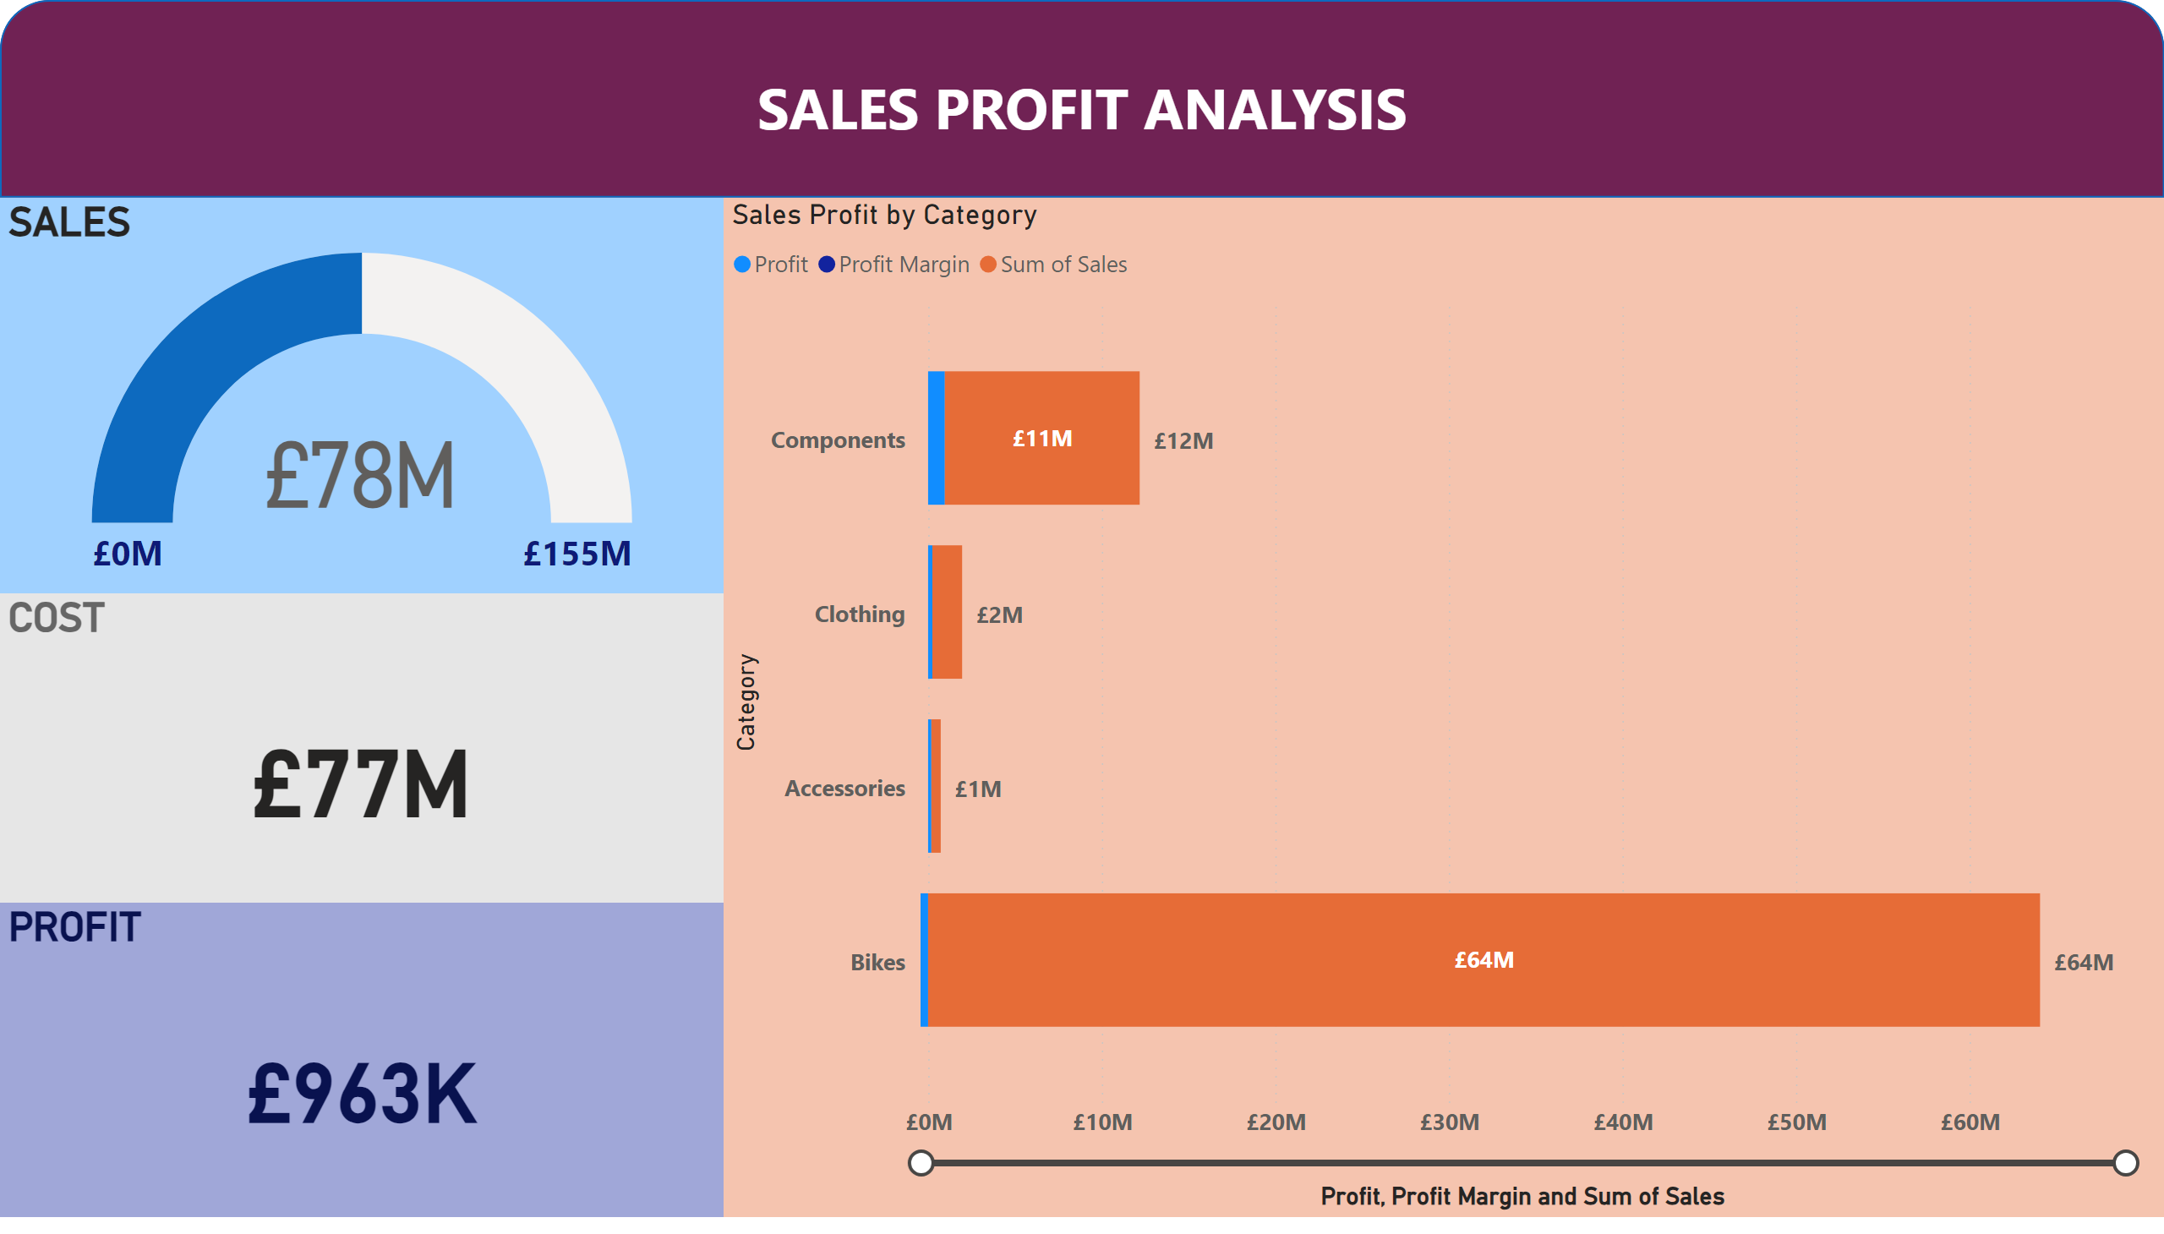
Page 2
Notes:
PROFIT
No alt text provided
COST
No alt text provided
SALES
No alt text provided
Sales Profit by Category
No alt text provided
shape
No alt text provided

Slide 3
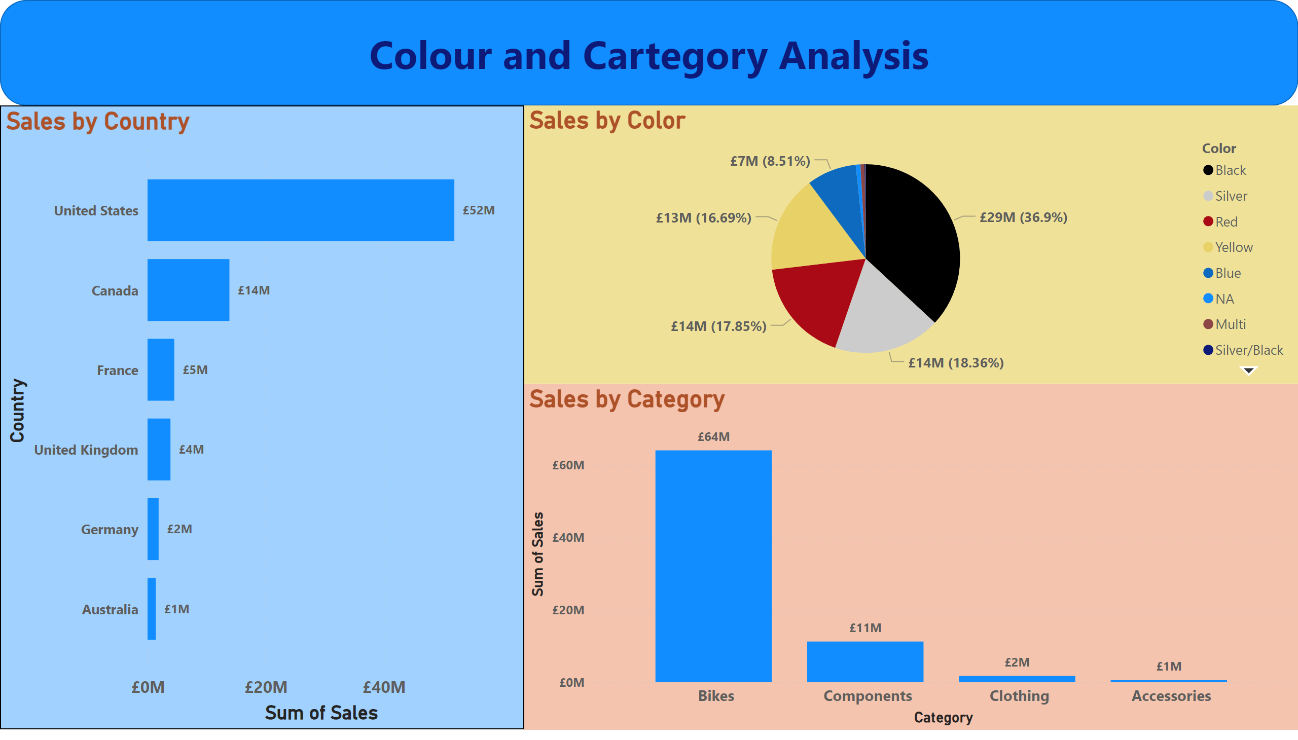
Page 4
Notes:
Sales by Country
No alt text provided
Sales by Color
No alt text provided
Sales by Category
No alt text provided
shape
No alt text provided

Slide 4
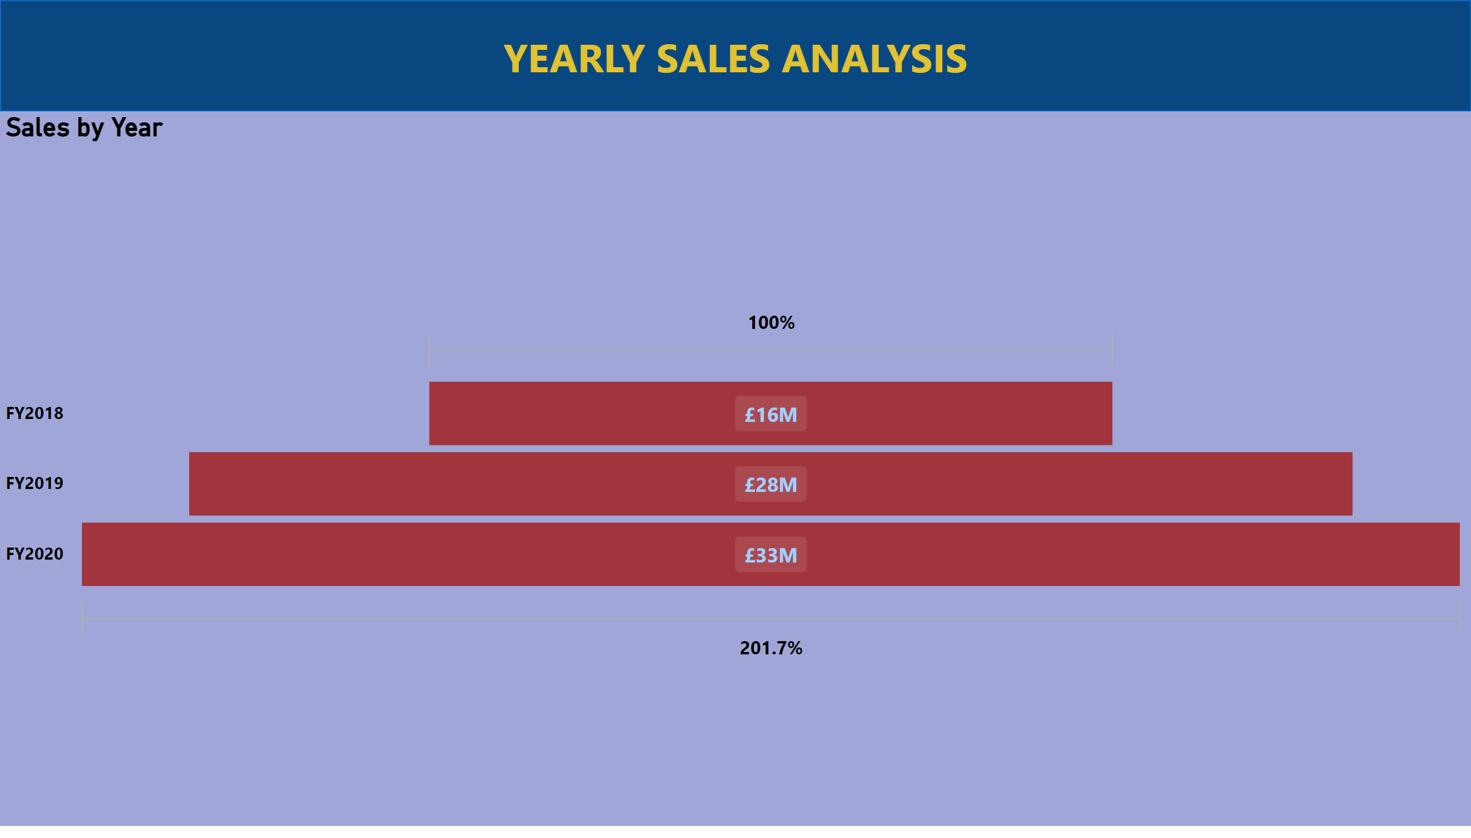
Page 5
Notes:
Sales by Year
No alt text provided
shape
No alt text provided

Slide 5
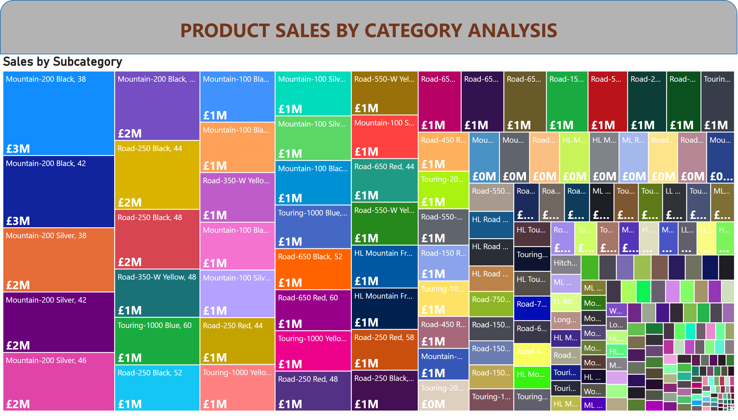
Page 6
Notes:
Sales by Subcategory
No alt text provided
shape
No alt text provided

Slide 6
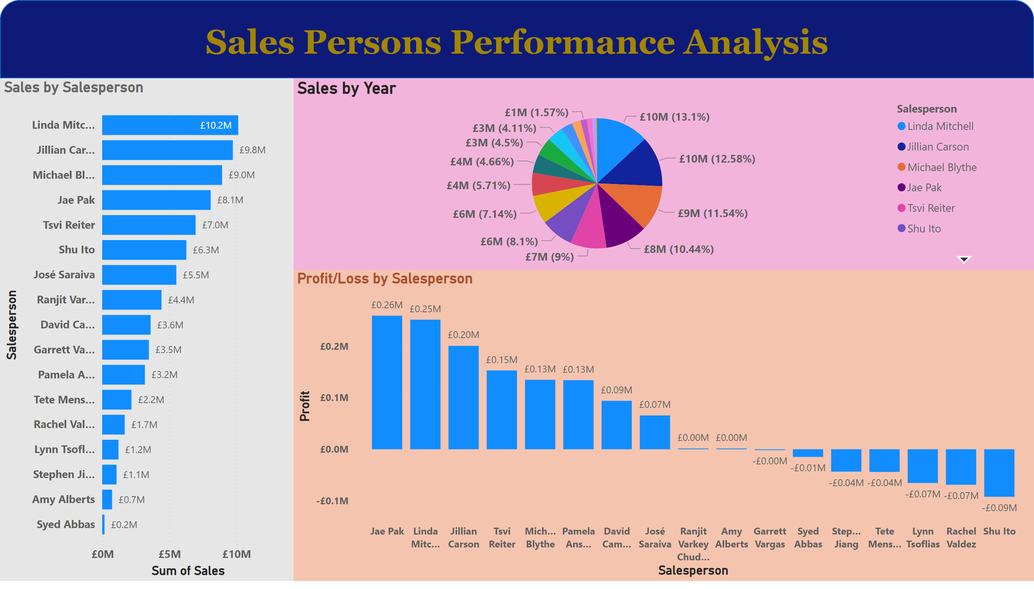
Page 7
Notes:
Sales by Salesperson
No alt text provided
Profit/Loss by Salesperson
No alt text provided
shape
No alt text provided
Sales by Year
No alt text provided

Slide 7
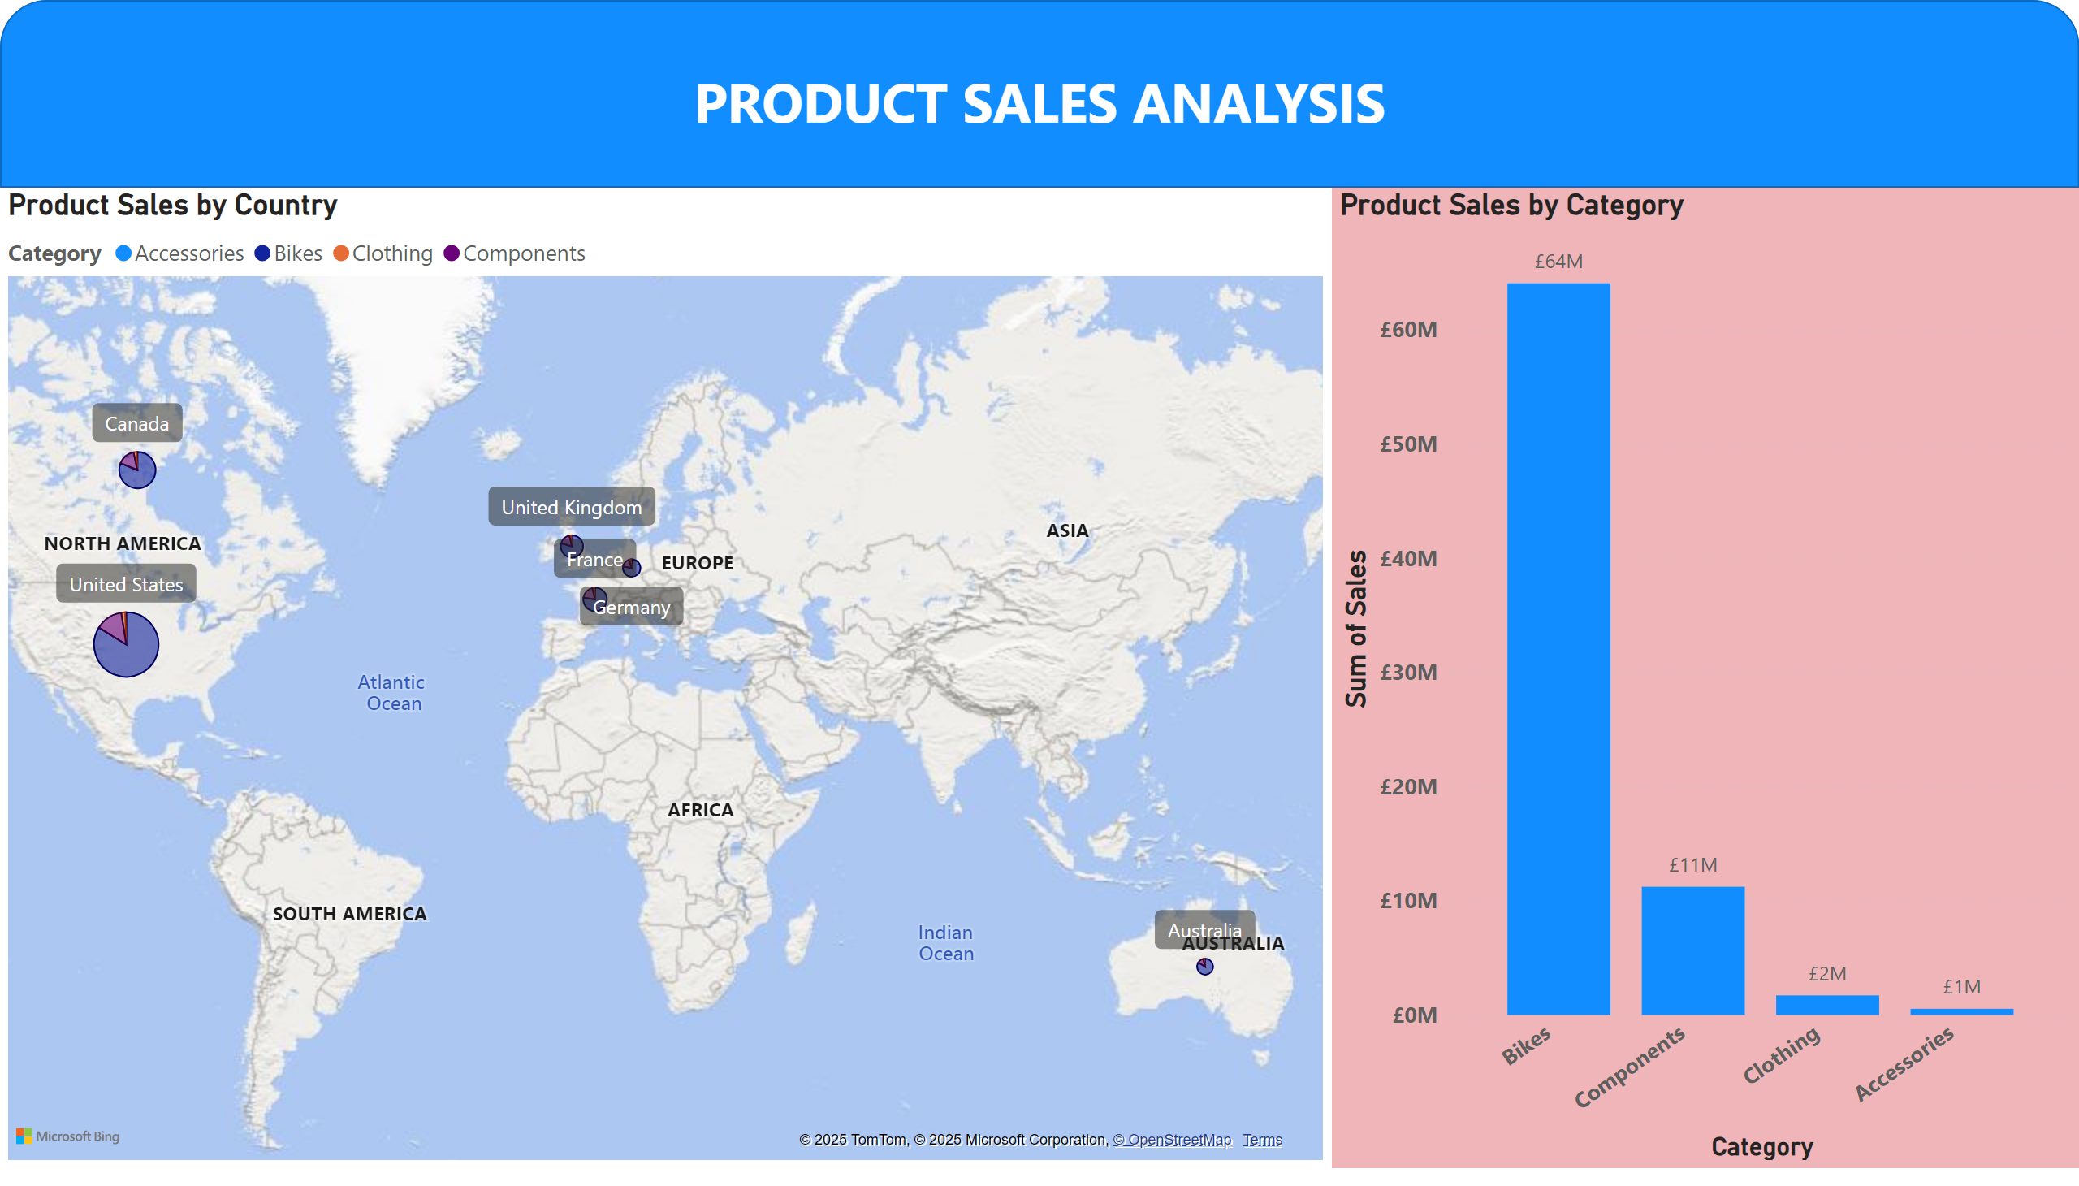
Page 1
Notes:
Product Sales by Category
No alt text provided
Product Sales by Country
No alt text provided
shape
No alt text provided

Slide 8
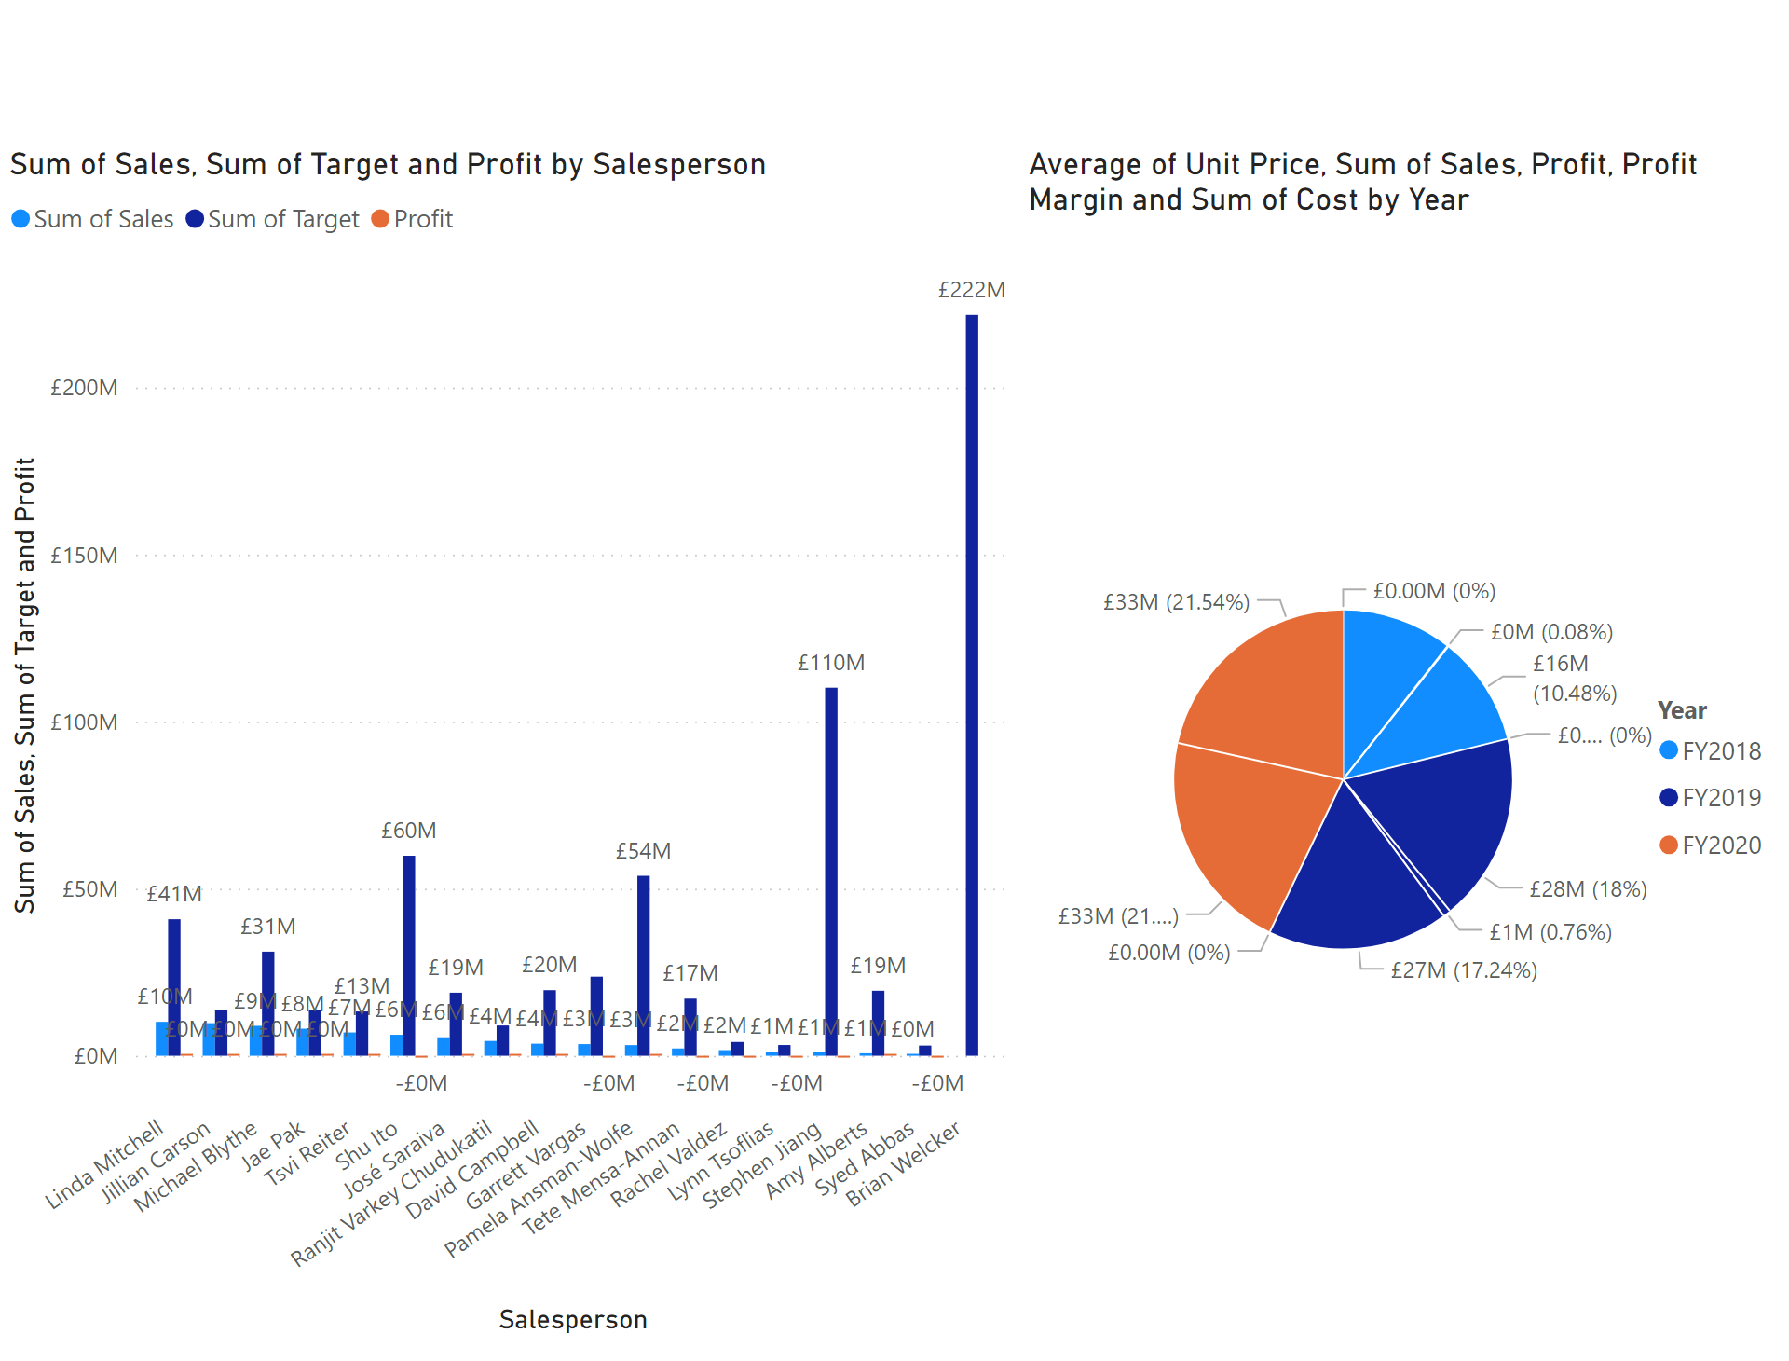
Page 8
Notes:
pieChart
No alt text provided
clusteredColumnChart
No alt text provided

Slide 9
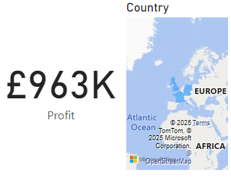
Tool Tip
Notes:
card
No alt text provided
filledMap
No alt text provided

